Slide 1


LLM Finetuning on NVIDIA data
Team Bangbang

Slide 2
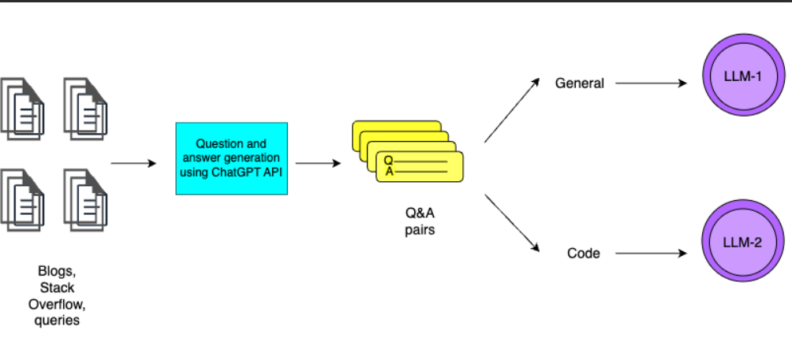
Pipeline

Slide 3
Data Extraction
The training dataset contains of textual data scraped from forums like NVIDIA forum, Stackoverflow platform, NVIDIA SDK.
These data contains all the text present in all the user based queries present on the platform.
All these textual data has been processed with OpenAI API for creating questions and answers from the textual data.
Libraries used: BeautifulSoup, Selenium

Slide 4
Training Data
Training data was created by using the gpt-3.5 model.
Training data consisted of questions and answers from the text extracted from the forums extracted.
Training data consists of generic questions and code based queries.
These queries have been used to finetune the LLM.
We have used about 7K generic questions and about 6.5K questions from stackoverflow.

Slide 5
LLM 1
In the previous image shown, LLM 1 is Falcon 7b LLM used for finetuning on generic data and was loaded in 8 bit configuration, with fp16 precision for computations.
This LLM is trained on data extracted from NVIDIA Forum, NVIDIA SDK.
Parameters used :- Rank = 32 , Alpha = 64 (normalization factor)
The generation configuration parameters can be adjusted during inference. We have set the temperature to be near 0 for factual responses.
These selection of parameters is done after some experimentations.

Slide 6
LLM 2
In the image, LLM 2 refers to Gorilla-7b parameter LLM, which pretrained on code data and was loaded in 8 bit configuration, with fp16 precision for computations.
This LLM is trained on data extracted from stackoverflow. (Third party source where developers communicate)
Parameter used :- Rank = 32 , Alpha = 32 (normalization factor)
This LLM is mostly trained on data which contains code based queries with positive upvotes.
The generation configuration remains the same as previous and can be changed.

Slide 7
Finetuning process
Each model took about 20 minutes on the MU DGX A100 with 40 GB GPU split, this was dependent on the evaluation loss observed and monitored on the Weights And Biases dashboard.
Only a few samples were passed while training in a batch in order to avoid overload on the GPU (16 training samples and 8 evaluation samples)

Slide 8
Infererence
The type of query should be mentioned during the inference for better outputs.
Generation configuration parameters can be changed for personalized results.
Both the models will be loaded when the Chatbot_final.ipynb is run, thus would require a lot of GPU requirements (18 GB on 8-bit)

Slide 9
Infererence
The type of query should be mentioned during the inference for better outputs.
Generation configuration parameters can be changed for personalized results.
Both the models will be loaded when the Chatbot_final.ipynb is run, thus would require a lot of GPU requirements (18 GB on 8-bit)

Slide 10
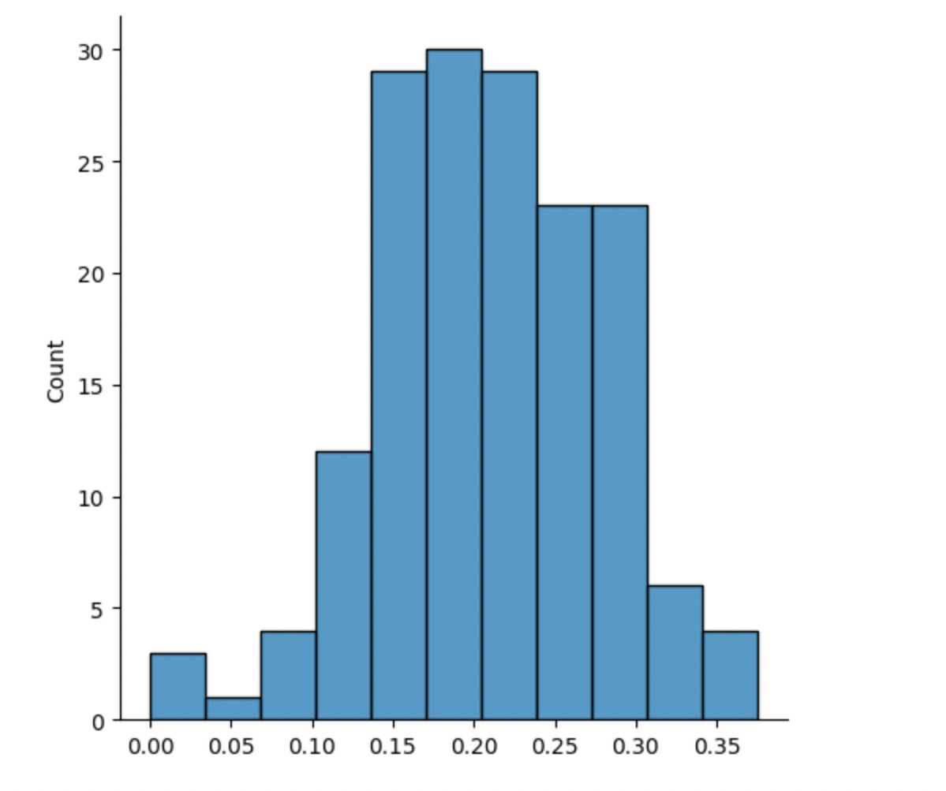
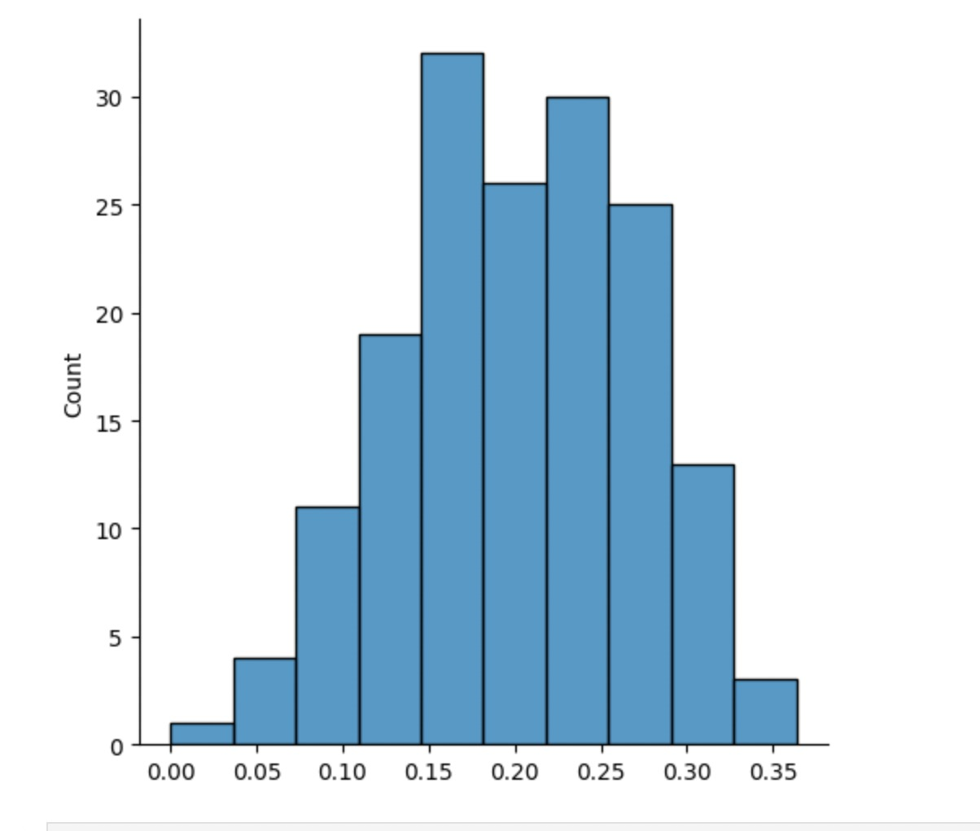
Evaluation
F1 and ROUGE scores were used on the generic questions and the cross entropy loss was measured on the distributions of the gorilla LLM.
F1 scores
Rouge

Slide 11
The generic queries were mostly related and matched the answers generated.
The evaluation loss for the generic LLM was around 1.15 while it was near 2.9 for the LLM finetuned on code data.

Slide 12
Limitations and improvements
High GPU memory usage for inferencing and training. Requires about 18 GB GPU on 8 bit loading and 30 GB for each model for fine-tuning.
High inference time, each question takes about 20 sec on A100 GPU inferecnce with max_new_tokens = 200.
Due to resource limitations, we have only used 25% of the stackoverflow data for finetuning, thus using more data could help in achiving better results.
Bigger models were not used due to the same reason such as falcon-40B on 8 bit, etc.
Usage of APIs can be helpful while inference, which can give much more relevant and updated information.

Slide 13
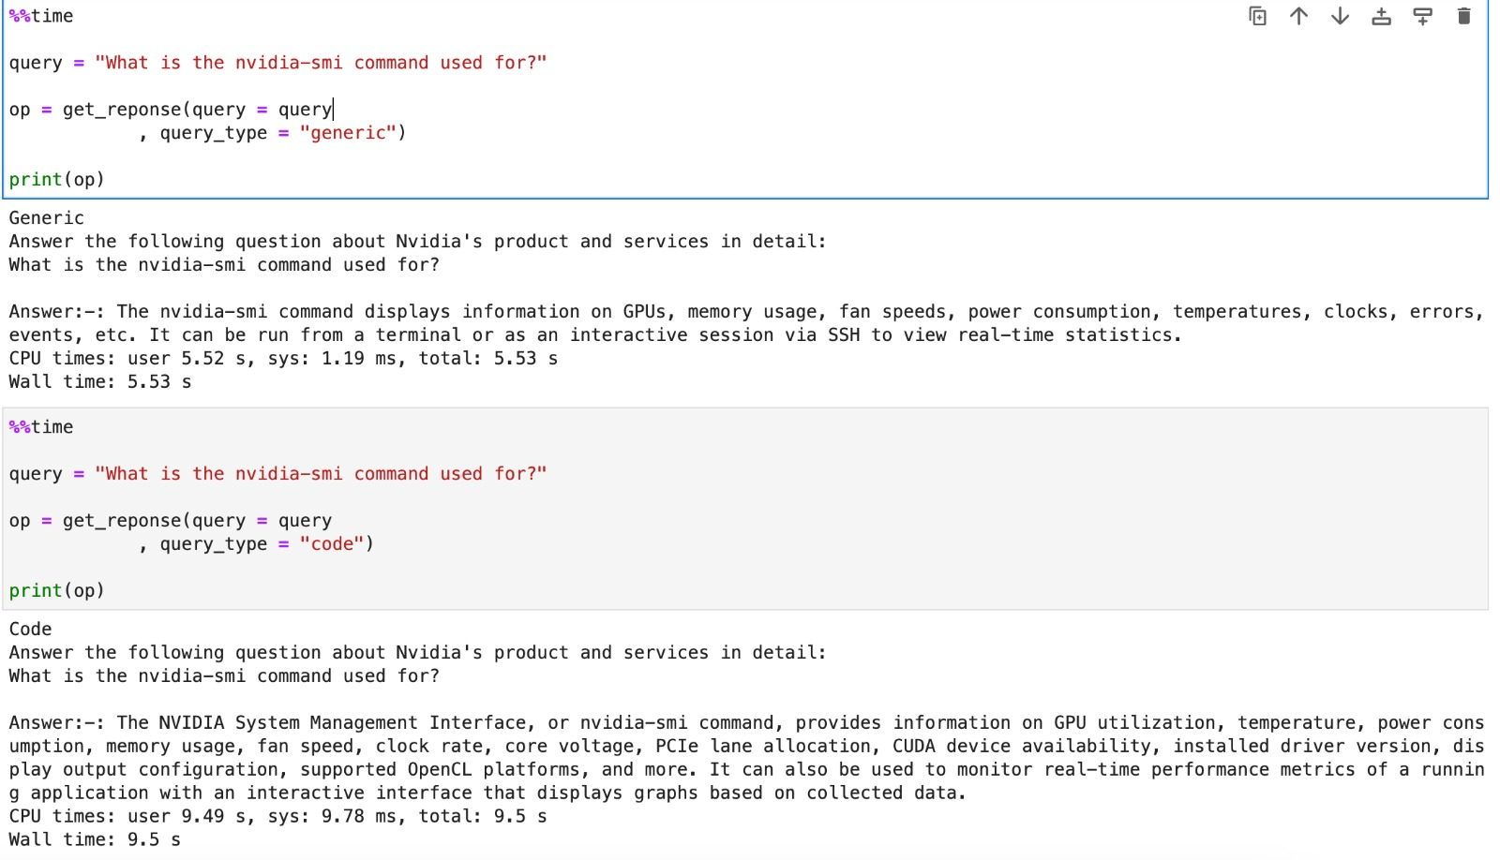
Example responses

Slide 14
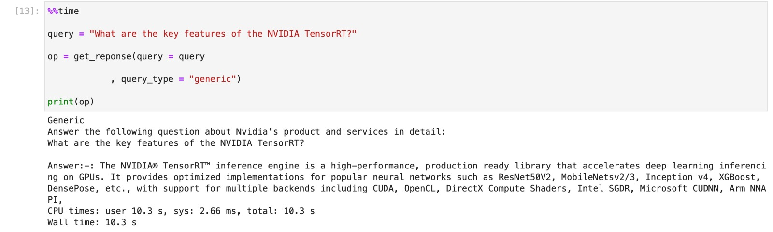

Slide 15
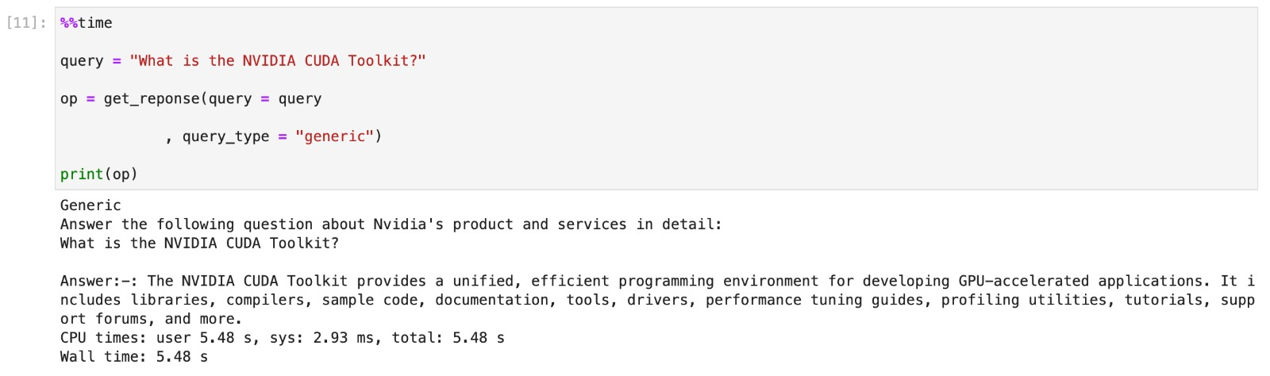

Slide 16
Teammates
Krishna Vamshi
Sreevaatsav Bavana
Chaitanya Srikanth
Sujith Sai
Deepesh

